Slide 1
Open Health Data
a challenge for improving health services
3rd meeting, eHealth Ecosystem, 30/9/2014
Michalis Vafopoulos, GFOSS, vafopoulos.org
Theodoros Karounos, GFOSS

Slide 2
Welcome to the data era

Slide 3
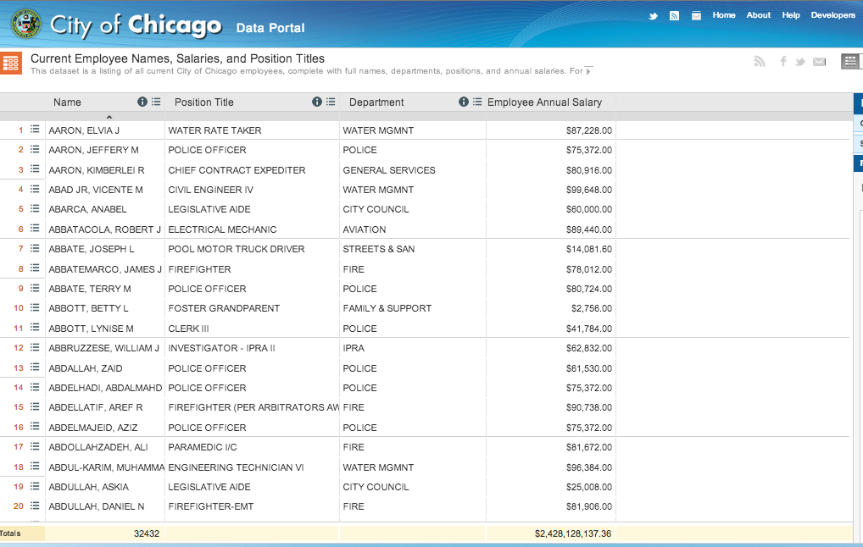

Slide 4
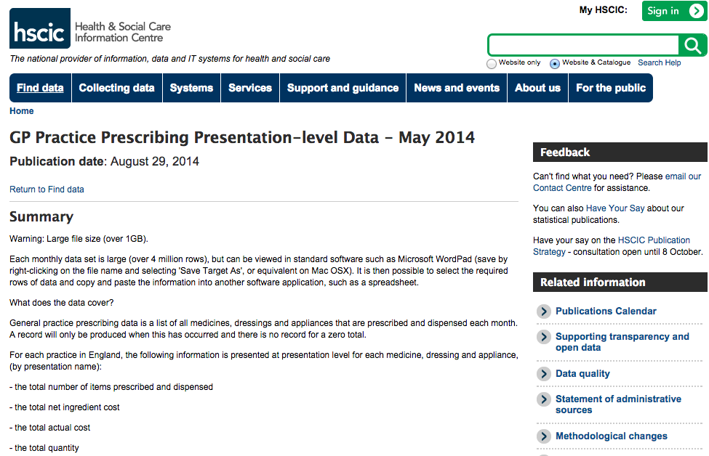
http://goo.gl/AV6dzg

Slide 5
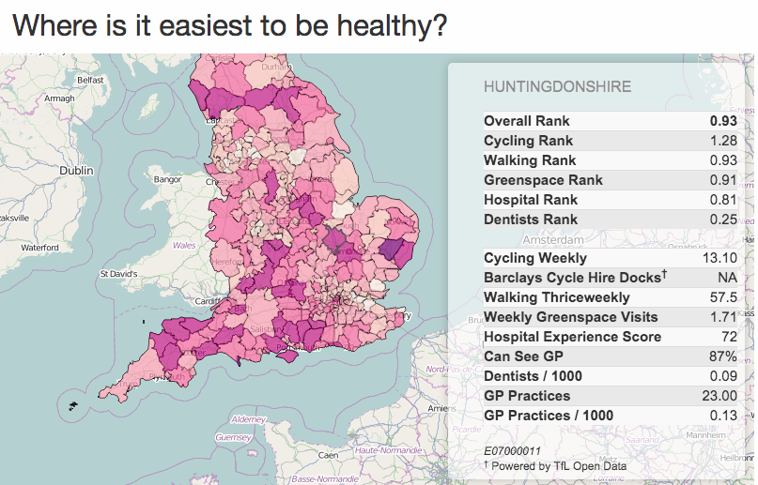
http://openhealthdata.cdehub.org/toothpick.html

Slide 6
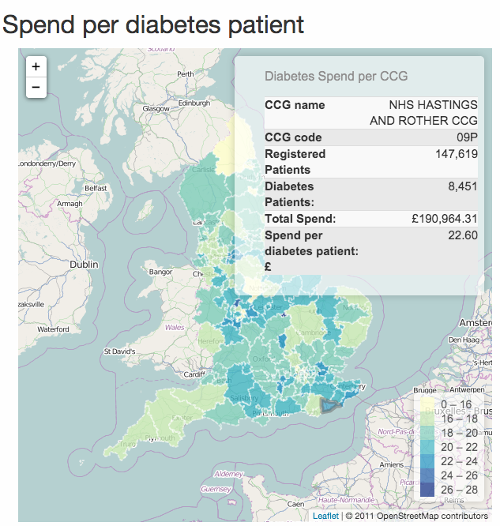
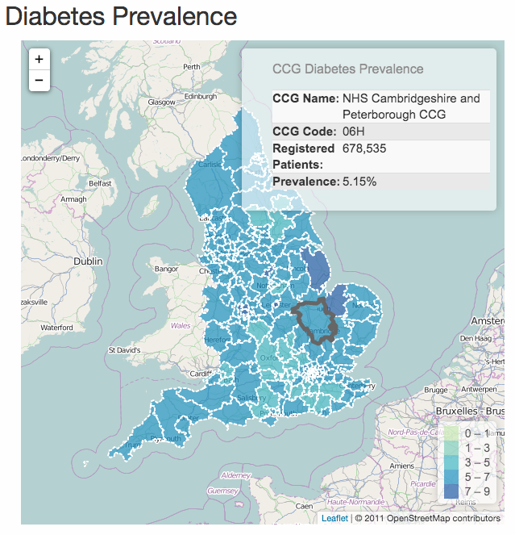
Over 2.4 million people in England or about 5.5% have diabetes. On average £24.45 is spent per diabetes patient per month on prescriptions to treat their condition.
http://openhealthdata.cdehub.org/diabetes.html

Slide 7
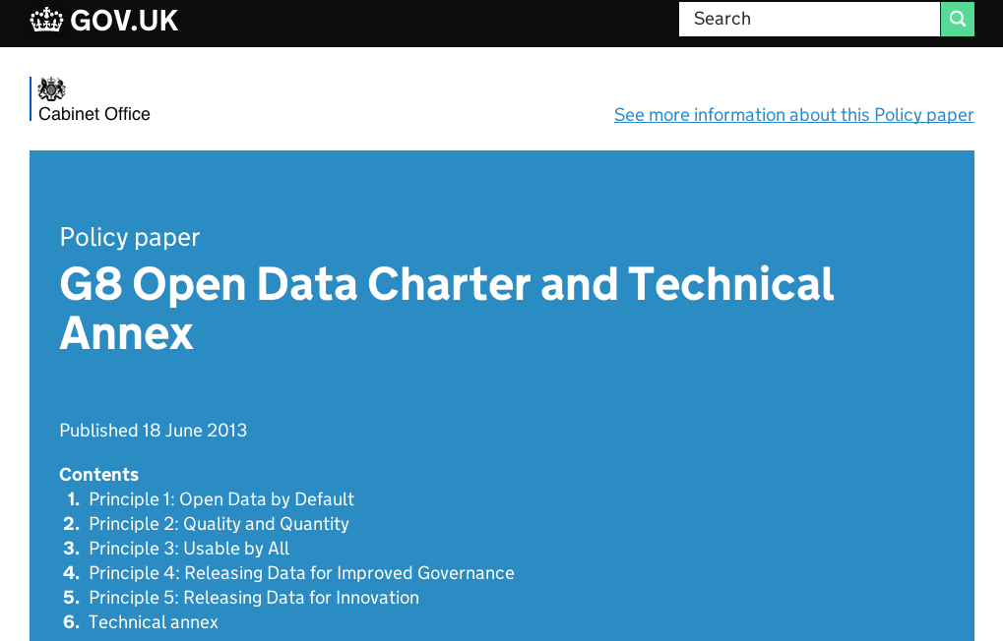

Slide 8
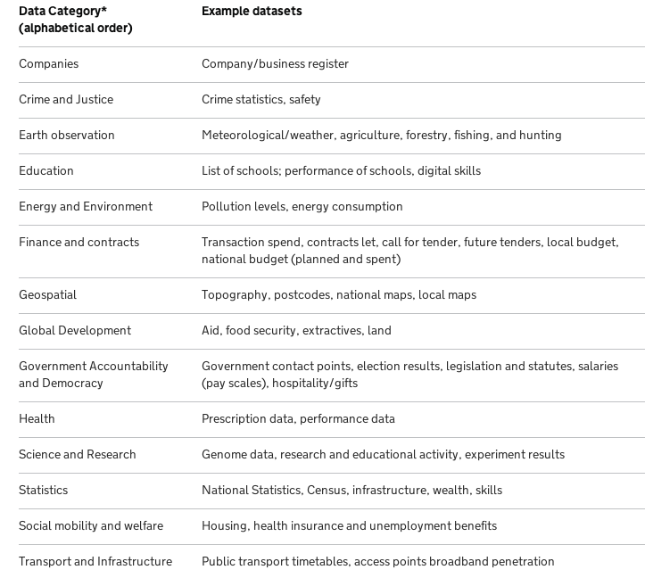

Slide 9
Data: Open, big, linked
Open: access
…everyone to use and republish as she wishes
Big: scale
high volume, velocity and variety
Linked: use
Publish once, use as many times

Slide 10
Why open health data?
Accountability
Political, Economic, Citizen Involvement, Clinical
Choice Variety, Quality of information
Efficiency
Operational, Economic, Treatment, Resource allocation
Customer Service & Patient Satisfaction
Quality, Quantity of patients served
Innovation & Economic Growth
Labour, Economic, Research

Slide 11
How open health data?
The platform is here (data.gov.gr)
we are missing the data…
A national plan for releasing data (both short & long term) based on procrastination principle

Slide 12
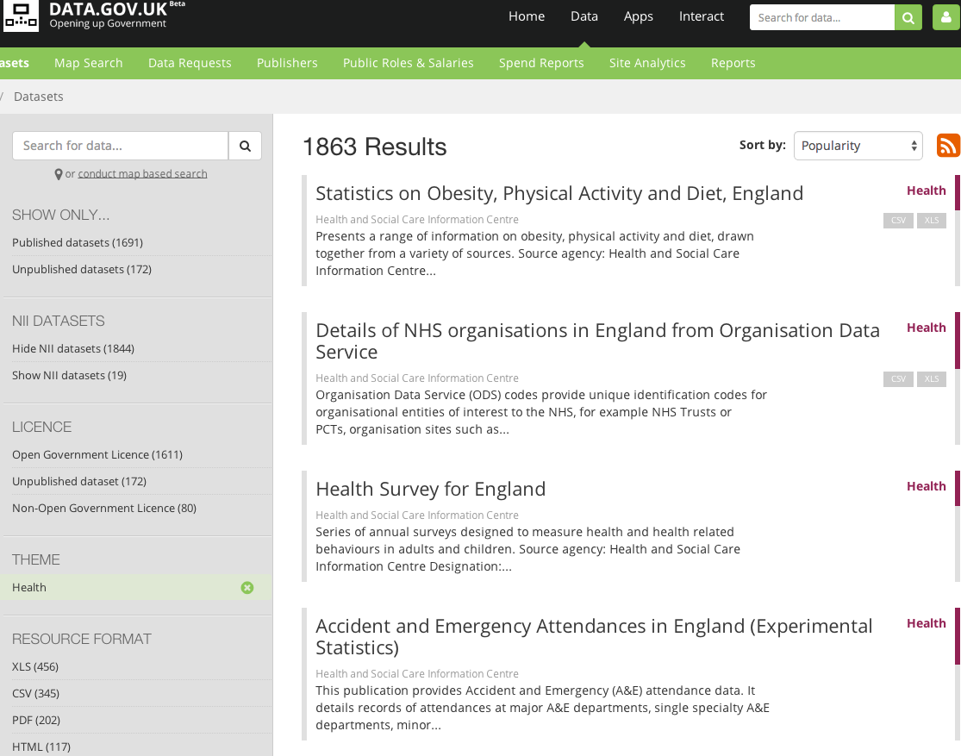
Hard to open a closed and fragmented world but it has become too expensive and inefficient to sustain it.

Slide 13
Thank you! Questions?
https://ellak.gr/
@vafopoulos
www.Vafopoulos.org

Slide 14
More info
Μεγάλη Βρετανία http://www.hscic.gov.uk/transparency
δεδομένα για τη συνταγογράφηση και άλλα ζητήματα υγείας
http://www.hscic.gov.uk/searchcatalogue?infotype=0%2fOpen+data&sort=Most+recent&size=10&page=1#top
Γενικότερα δεδομένα https://www.healthdata.gov/
The Open Data Era in Health and Social Care http://thegovlab.org/nhs/
Δράσεις http://nhshackday.com/
- Επιχειρήσεις, http://www.openmhealth.org/about/, http://www.openhealthcare.org.uk/about/
Στον τύπο
Power to the people: how open data is improving health service delivery
UK Healthcare Agency Reveals Open Data Blueprint
Έρευνα
Liberating Data to Transform Health Care: New York’s Open Data Experience

