Slide 1



EARLY STEM: WHAT ARE THE NEEDS OF TEACHER TRAINING TO EXPLORE STEM WITH THE YOUNGER STUDENTS
Angelopoulos Takis GFOSS - Hellenic NCP
Iraklis Varlamis,Assistant Professor, HUA
Eleftheria Papageorgiou, Graduate Student, HUA
Christos Chronis, Ph.D. Candidate, HUA

Slide 2
GFOSS
GFOSS
Open Technologies Alliance (GFOSS) is a non-profit organization founded in 2008, 37 Universities and Research Centers are shareholders of GFOSS. The main goal is to promote Openness through the use and the development of Open Standards and Open Technologies in Education, Public Administration and Business in Greece.
A platform for Open Standards, Free Software, Open Content, Open Data & Open Hardware in Greece. The major Greek Universities and Research Centers participate in GFOSS, while leading members of the Greek community of developers play a key role in the implementation of our policies.

Slide 3
GFOSS
Affiliated with Creative Commons,
Founding member of COMMUNIA and FAB LAB ATHENS,
Member of a) the Open Government Partnership (OGP) Network, b) Open Budget Initiative , c) the Open Policy Network, d) Eclipse Foundation
Node of the Open Data Institute,
Partner of the Open Forum Europe,
Associate Organisation of FSFE (Free Software Foundation Europe),
Associate Organization of OW2 Consortium and
Local hub of MyData (/).
GFOSS also cooperates with the Enterprise Europe Network – Hellas in the ICT sector, with the aim to assist companies that provide Open Technology services. Nine members of GFOSS participate in GRNET‘s project, FOSS Centers of Excellence, the centers deliver training activities for developing and promoting FOSS software in ten subject areas.
GFOSS has a framework agreement with the Ministry of Education

Slide 4
Actions Related to Early STEAM
All GFOSS actions related to STEAM are targeting Early STEAM education
Workshops (distance or face to face)
STEAM Laboratory specifications (Open Labs)
Open Robotics Competition (Pre-primary School Projects, Primary School Projects)
The FOSSBOT Project

Slide 5
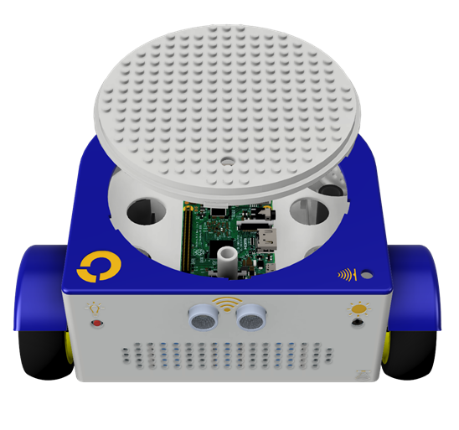
The FOSSBOT Project
An open design and software approach to develop a low cost solution for supporting STEAM education
Three (or more) usage modes for all educational levels: nursery schools, primary and secondary schools and vocational training schools
It provides
Designs and guidelines for 3d-printing the robot parts
Simple assembly instructions for the electronics
A manual for the operation of the software
Educational activities at all levels (four courses in Moodle)
Everything is available at github (eellak/fossbot)

Slide 6
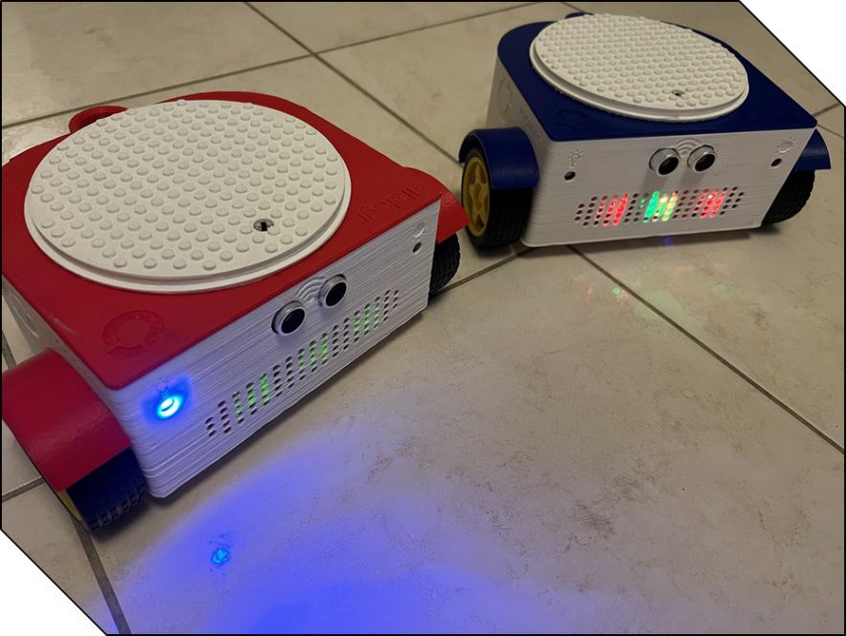
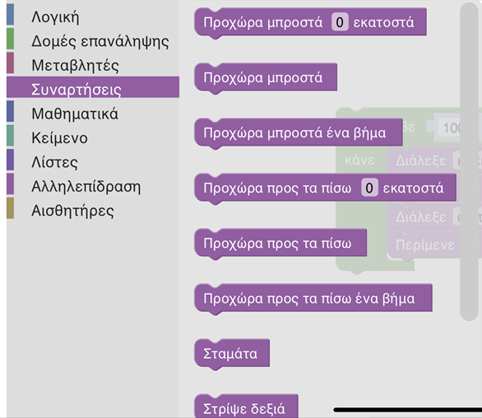


The FOSSBOT Project
kindergarten
Elementary school
Friendly UI: buttons
Control using tablet or smartphone
Expandable UI: new buttons that execute python or blockly scripts can be added
Custom UI with code blocks for the Fossbot

Slide 7
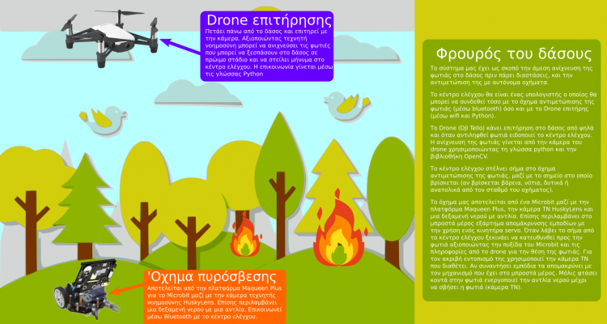
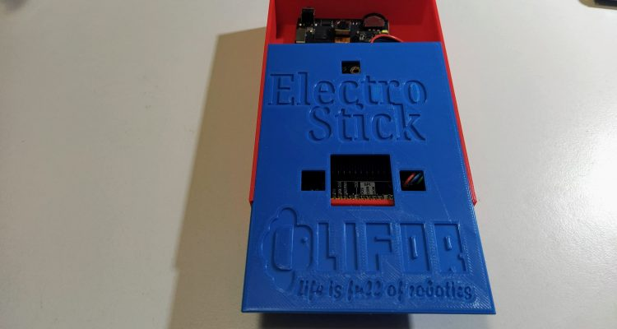
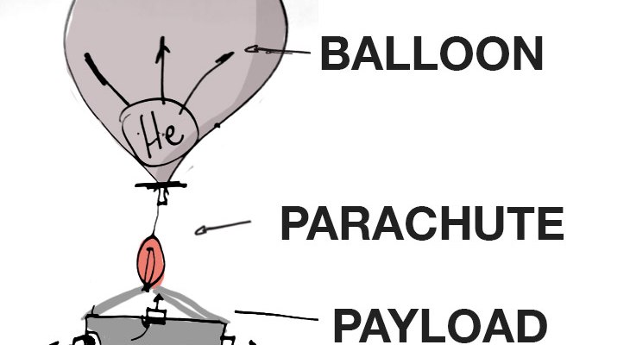
Open Robotics Competition
Sensitivity and tendency to engage children and teachers with issues related to
the environment,
climate change,
green transition,
green development and
proposals for solutions to real everyday problems.

Slide 8
Open Robotics Competition
Provides an opportunity for organizers, sponsors, educators and policy makers to discuss the role and prospects of STEAM education currently occupying the international educational community such as:
How can technology support the teaching of STEM and non-STEM subjects
How to reduce the gender gap in STEM fields
What is the role of schools in the Green Transition
What are the key elements to ensure that all students have equal opportunities to learn STEM
How can teachers use real-world situations to teach STEM
What are the latest trends in STEM training
What are the steps required to promote STEM training outdoors
What are the needs in teacher education for STEM exploration especially with younger students- The introduction of STEAM at early stages

Slide 9
Conclusion
Bringing together a cohort of experts in the field STEAM in Early Childhood Education to explore the ways STEAM can be integrated into early childhood curricula, highlighting recent research, actions, programs and innovations in the field, and to investigate implications for both practice and policy.
Setting the scene we can look beyond the classroom, school, curricula and discuss how teachers can support STEM learning in museums, nature-based learning outdoors, after-school programs etc.
To mention challenges and opportunities based on the argument that high-quality STEAM education needs to start early and that early childhood education must include science, technology, engineering, and mathematics in developmentally appropriate ways based on the latest research, theories and initiatives.
To discuss solutions and best practices on “What are the needs in teacher training to explore STEM with the younger students” as a) it teaches the importance of making connections and helps to build these skills, b) children brains are primed to take in new information and c) because maths and science are often two subjects that give kids much trouble later in their school life

Slide 10
Thank you for your Attention

