Slide 1
Connect:
A new project in the Scientix Projects Database: What Connect means for Greece
Giorgos Panselinas
Project Manager of Connect
on behalf of the
Regional Directorate of P&S Education of Crete
panselin@gmail.com
https://www.connect-science.net/
Scientix Greece Event
29/5/2021

Slide 2
CONNECT:
A European funded project, under the Horizon 2020 Science with and for Society Programme,
to support schools to adopt open schooling,
in the core-curriculum
using participatory-science with families, research centres, universities and enterprises.
Scientix Projects Database – OpenSchoolingTogether

Slide 3
How can Connect help you improve science education?
https://www.connect-science.net/

Slide 4
Content:
The limitations of science education
WHAT is CONNECT?
What does CONNECT offer?
  Care-Know-Do (CKD) model
  Science-actions: Open-ended and structured scenarios
  CONNECT platform
  Partnerships
  Coaching
  Engagement
CONNECT in a nutshell (goals)
HOW to benefit from CONNECT?
HOW to get involved in CONNECT?

Slide 5
1. The limitations of science education
The importance of science capital

Slide 6
We all want more young people to be able to think scientifically in their everyday life and to aspire to a career in science
According to recent research, there are too many students thinking that ‘science is not for me’.
Why is it so difficult to change it?

Slide 7
These students lack the so-called ‘science capital’, which refers to their scientific knowledge, attitudes, skills and experience. This especially affects those from disadvantaged backgrounds.
These students may not see themselves as future scientists due to key factors that influence their aspirations:
Low cultural familiarity with science;
Lack of role models;
Limited opportunities to engage with
science outside formal education.
What can we do?

Slide 8
The SOLUTION is to change how students learn science and make science education more accessible and appealing to students by adding more opportunities into the curriculum that allows them:
MOTIVATION:
to learn science through the scientific method
to increase the capabilities and motivation towards science careers for all students equally
ENGAGEMENT:
to interact with scientists
to engage students' families in a participatory science process
to stimulate a shared interest in science and future careers within families
IMPACT:
to contribute to solve community challenges
to be aware of the impact of science in the world

Slide 9
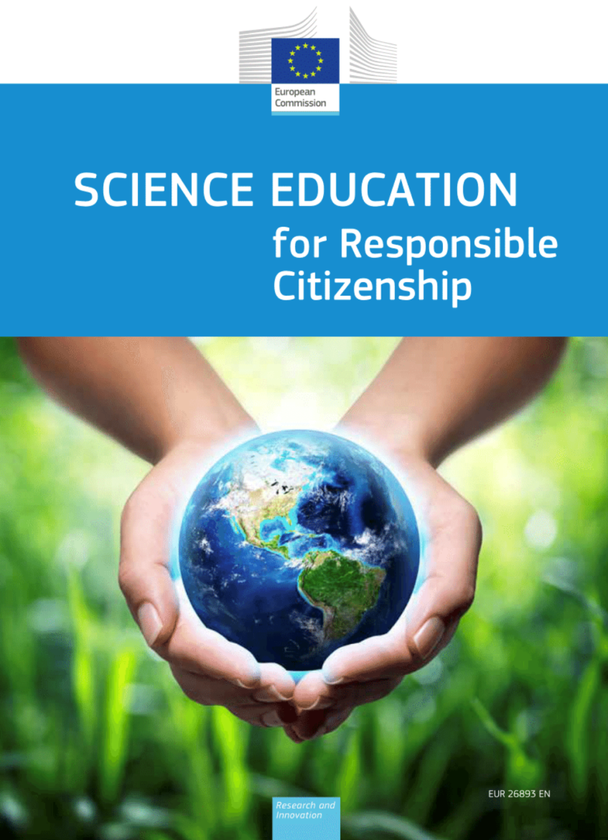
The term “open schooling” emerged in 2015
Open Schooling is a novel approach promoted by the European Commission to support cooperation between schools with scientists and local communities for youth to solve real problems.
Schools, in cooperation with other stakeholders, become an agent of community well-being;
Scientists from enterprise, civil and wider society are actively involved in bringing real-life projects into the classroom;
Local Communities including families are encouraged to become real partners in school life and activities.
The European Commission’s goal is to increase the uptake of science studies and science-based careers to improve scientific literacy, employability and competitiveness.

Slide 10
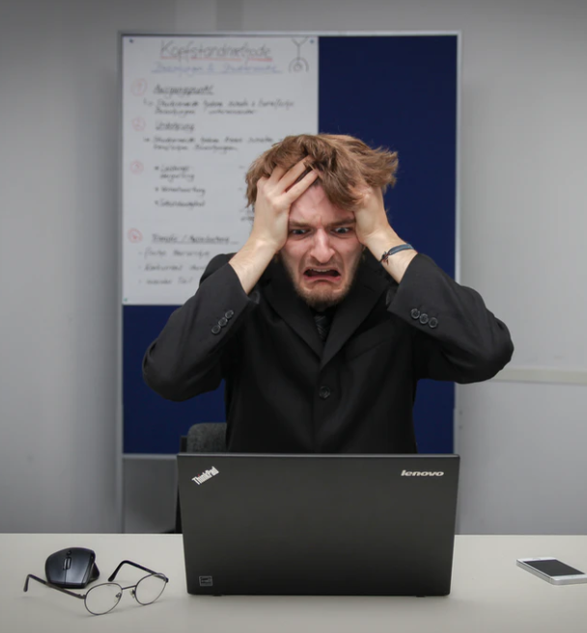
What could prevent me, as a teacher, to promote change towards open schooling?
Promoting Science capital by engaging stakeholders is difficult & takes time
Tight curricula
My science lessons are already highly valued by my students
I do not know how to start the change
I do not see the value of collaborating with stakeholders outside my school
It is not my duty to improve the role of science in my community
During this presentation we will describe what CONNECT can offer to overcome these diffiiculties.

Slide 11
CONNECT focuses in three main pillars:
 | What it is? | Its impact
OPEN SCHOOLING | Refers to schools/universities that become an agent of community well-being by connecting real-life projects to their course in partnerships with scientists, enterprises, families and civil society. | Enables schools to create flexible and inclusive learning environment, inspiring students to explore the world through science.
SCIENCE-ACTION | Is a learning activity that makes science more relevant to students by showing them how scientific research and innovation can affect their lives, and how they can use science to make a positive impact as young researchers. | Encourages students to use science to benefit their lives, their community and society.
PARTICIPATORY SCIENCE | Offers an opportunity to interact with STEM professionals, as well as having opportunities to discuss science issues at home (family). | Increases students’ interest in science through engaging families, universities and enterprises to be part of school-life activities.

Slide 12
3. WHAT does CONNECT offer?
Educational materials, CKD model, CONNECT platform and partnership

Slide 13








CARE – KNOW – DO model
CONNECT will provide useful and innovative resources that follow the Care-Know-Do model to increase science capital involving students and teachers with scientists and families in three steps:
They are engaged with
a real-life issue
They acquire knowledge
and skills in science
They develop attitude for participatory science-action
Notes:
we-CARE informal learning with professionals and family introducing the challenge
we-KNOW formal learning focused on the students’ acquiring the scientific understanding and skills
we-DO students turn their knowledge and skills into participatory science-action including an evaluation

Slide 14
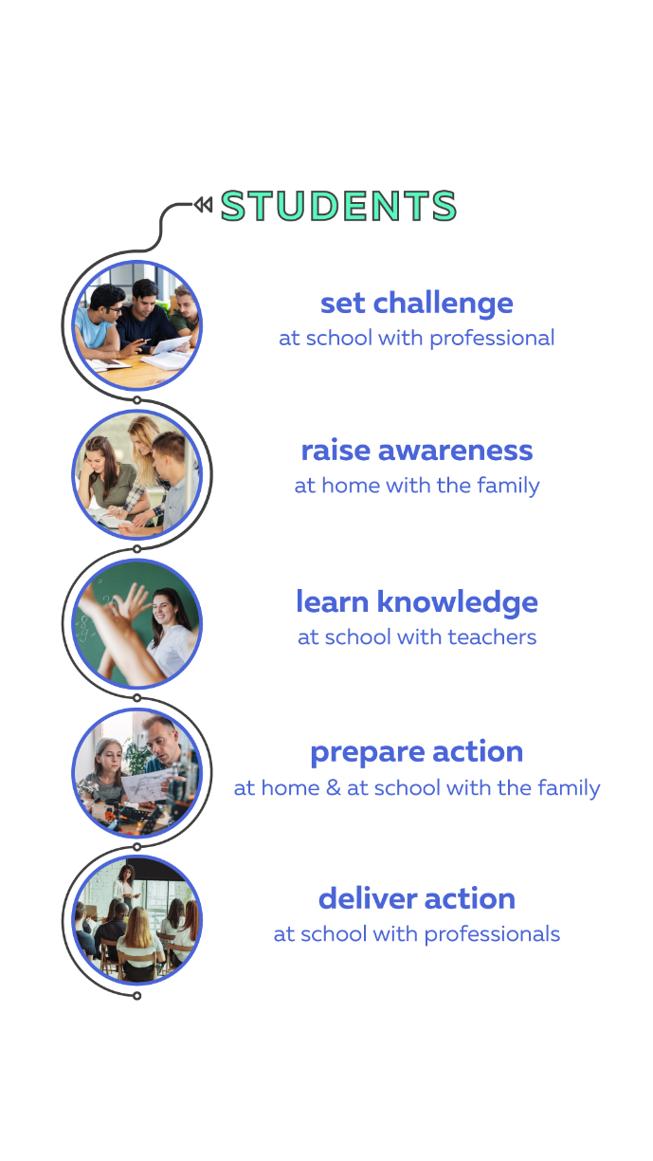
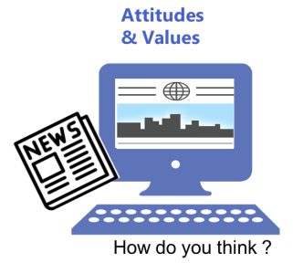

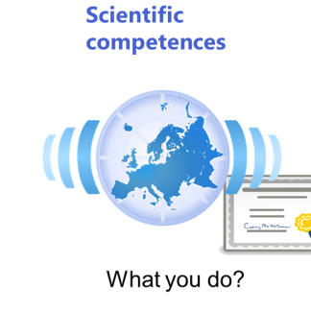
a) CARE – KNOW – DO model
The CARE-KNOW-DO model will focus on future-oriented scenarios in areas such as: Health/Food, Environment, Energy, Technologies, Science-society
we-CARE: informal learning with professionals and family introducing the challenge
we-KNOW: learning focused on the students’ acquiring the scientific understanding and skills
we-DO: students turn their knowledge and skills into participatory science-action including an evaluation
Notes:
we-CARE informal learning with professionals and family introducing the challenge
we-KNOW formal learning focused on the students’ acquiring the scientific understanding and skills
we-DO students turn their knowledge and skills into participatory science-action including an evaluation

Slide 15
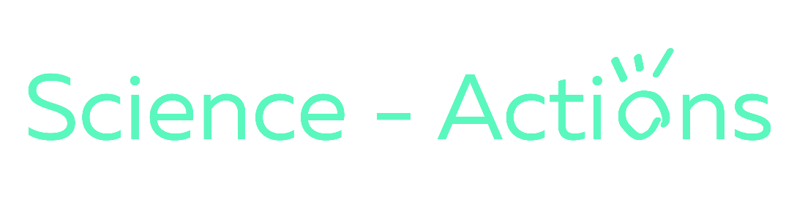
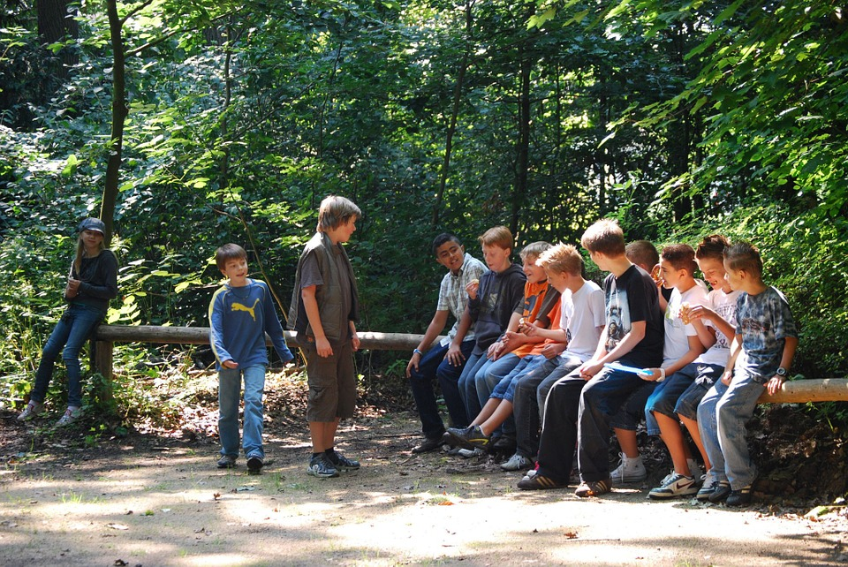
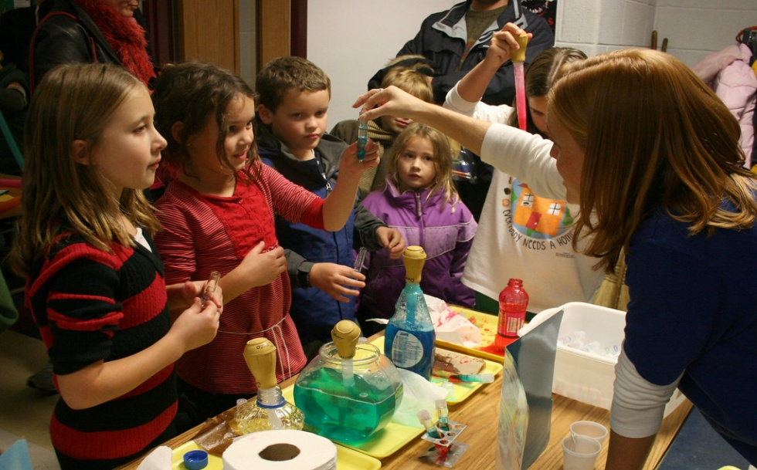
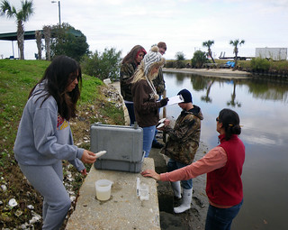
b) CONNECT resources
CONNECT will provide resources called Science Actions to complement existing units that tick many curriculum boxes and are easy for teachers to use:
Real-world challenges linked to the curricula
Fun tasks to apply science ideas
Engaging family activities
Inclusive strategies for teaching skills
Competence-based assessment
Future-oriented support from a scientist
Think -Talk outside school
Exploratory - Experimental Science
Citizen Science & Open Data

Slide 16
CONNECT resources
There are two kinds of science actions available for teachers/schools to support their projects:
  Structured scenarios – pre-defined activities that schools can easily customise to maximise the chance of a successful first-time project supported by science professionals.
  Open-ended scenarios – template for teachers/schools and science professionals to identify issues to be faced and develop their own activities.

Slide 17
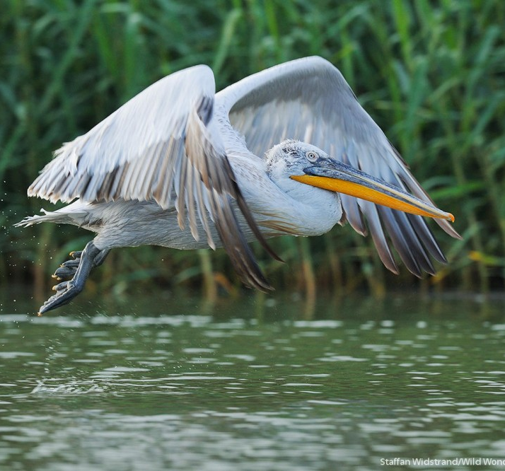
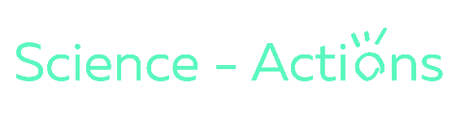
a) CONNECT resources: structured scenarios
REWILDING
The issue
Imagine your country 1000 years ago.​
Which species have been lost and why?​
Could we turn the clock back and ‘rewild’ an animal?
Care
Know 1
Know 2
Do
Set the challenge, choose an animal​ with families
Teach feeding relationships, competition. Apply knowledge ​
Teach abiotic & biotic factors. Apply knowledge​
Plan the campaign. Home preparation. Judge the campaigns

Slide 18
b) CONNECT resources: open ended scenarios
Science action stage​ | Steps​ | Methods​ | Participants ​ | Learning objective​
Care​ | Framing​ | Agenda setting​ | Students ​​ Experts / Scientists​​ Local community​​ Families​ | To develop engagement and interest by framing and finding approach to community-based challenge ​
 | Questions​
Know​ | Knowledge & opinions​ | Desk-top​ Interviews​ Stakeholder analysis​ ​ | Students ​ Experts / Scientists​ Local community​ Teacher​ UAB​ | To acquire scientific understanding of local issues and problem-solving approaches supported by research and interactions with scientists and stakeholders ​ to develop alternative solutions collaboratively​ ​
 | Deliberation​ | Consensus format​ Jury format ​ Co-creation​ | Fellow students ​ Experts / Scientists​ Local community​ Teacher​
Do​ | Recommenda-tions​ | ​ | Students ​ Experts​ | To communicate science actions projects and findings to the local community​ ​
 | Dissemination​ | Open letter with recommendations ​ Article ​ | Decision-makers​ Media ​ Stakeholders​
  Build upon a framework with two steps for each of the science action stage: CARE, KNOW, DO.
  Each step has different options for choice of method and participants.
  Students decide on a local challenge to work.
  Teachers facilitate the process, experts and local stakeholders provide knowledge. Coaches support teachers.
REWILDING

Slide 19
1st Year /2020-2021/CONNECT resources
Based on Rewilding Science Action:
Rewilding Greece – Marine Biology
Rewilding Greece – Terrestrial Biology
Open-ended Scenarios
Map skills for problem solving
Measuring CO₂ for coping with Covid-19 aerosol transmission
Plastics
Renewable Energy
Global Warming and Chemical Pollution

Slide 20
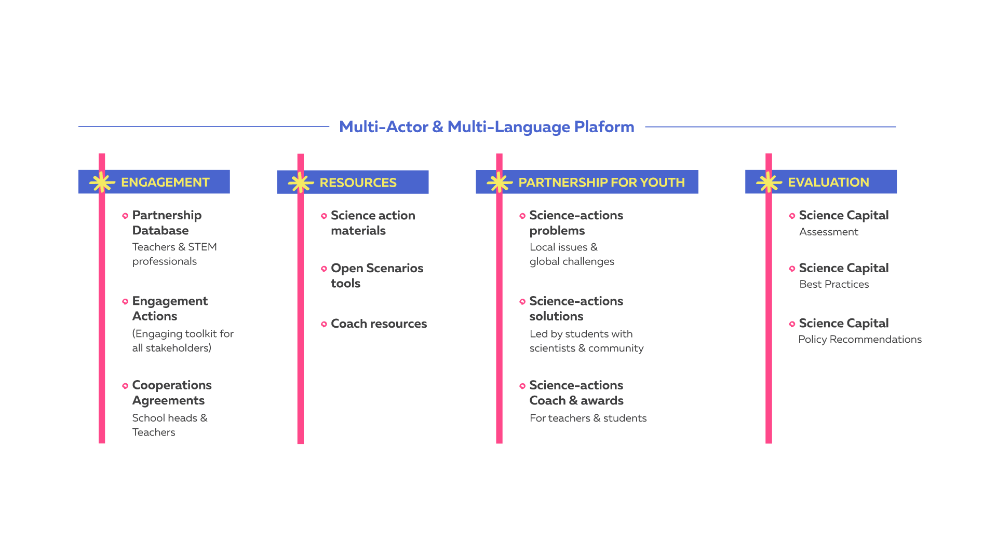
c) CONNECT Platform
CONNECT platform is a digital environment where teachers and science professionals can engage and collaborate with each other on exciting Science Action projects:

Slide 21
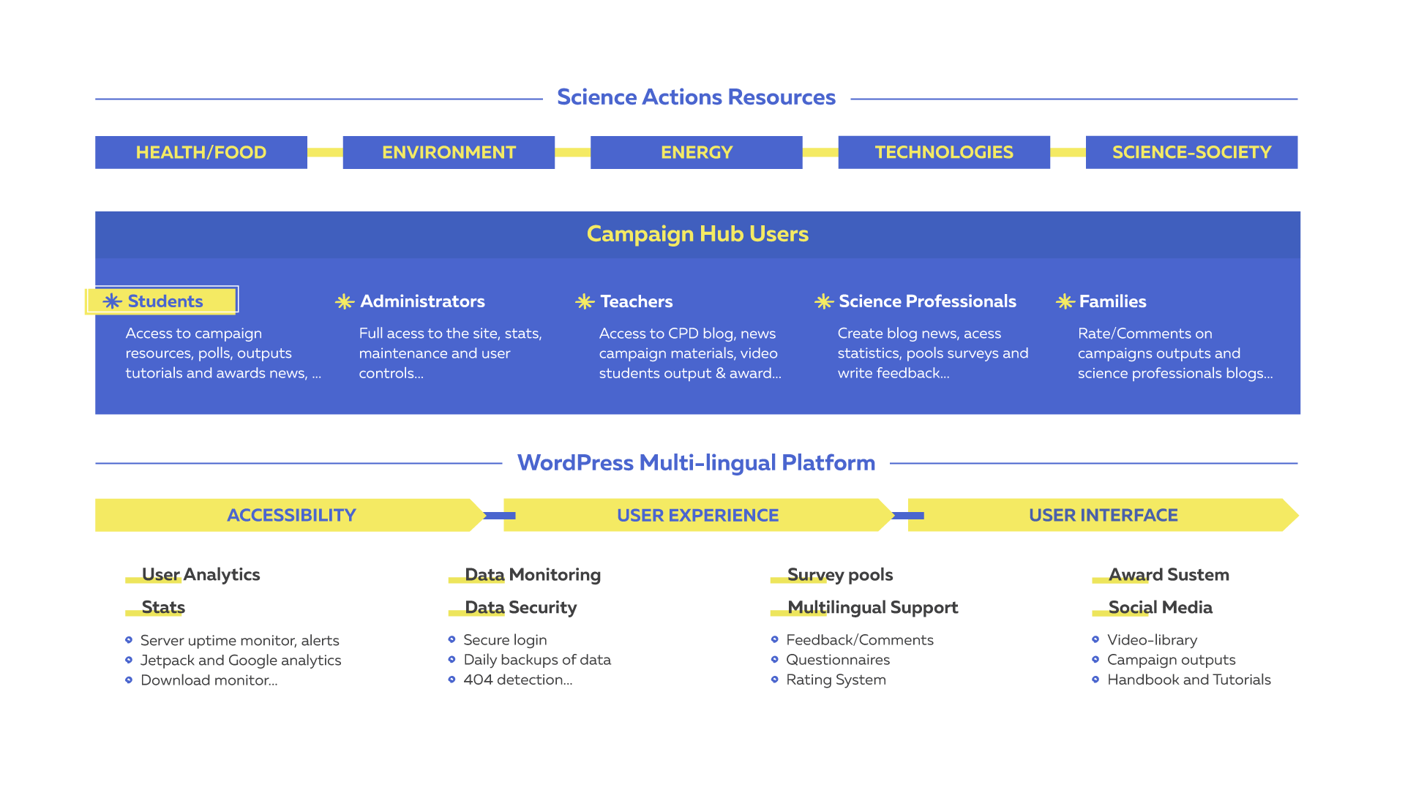
c) CONNECT Platform (for teachers)
As a teacher you can benefit from the CONNECT platform:
to engage, interact and collaborate with scientists and other teachers implementing science-actions
to get support from coaches (CPD blog) and webinars
to access inclusive, engaging and ready-to-use educational materials linked to curriculum to support your science lessons
to share students’ outputs
to obtain a participation open badge
to apply for special awards
Notes:
Our platform is built to answer the needs of secondary teachers, with creative educational materials and peers to CONNECT with – All in one place;
Benefit from inclusive, engaging and fun educational approaches and curriculum materials to support your science lessons;
Inspire your students by interacting with STEM professionals, and receive the support you need through coaching and webinars;
Stay tuned for a unique repository of best practices on open schooling.

Slide 22
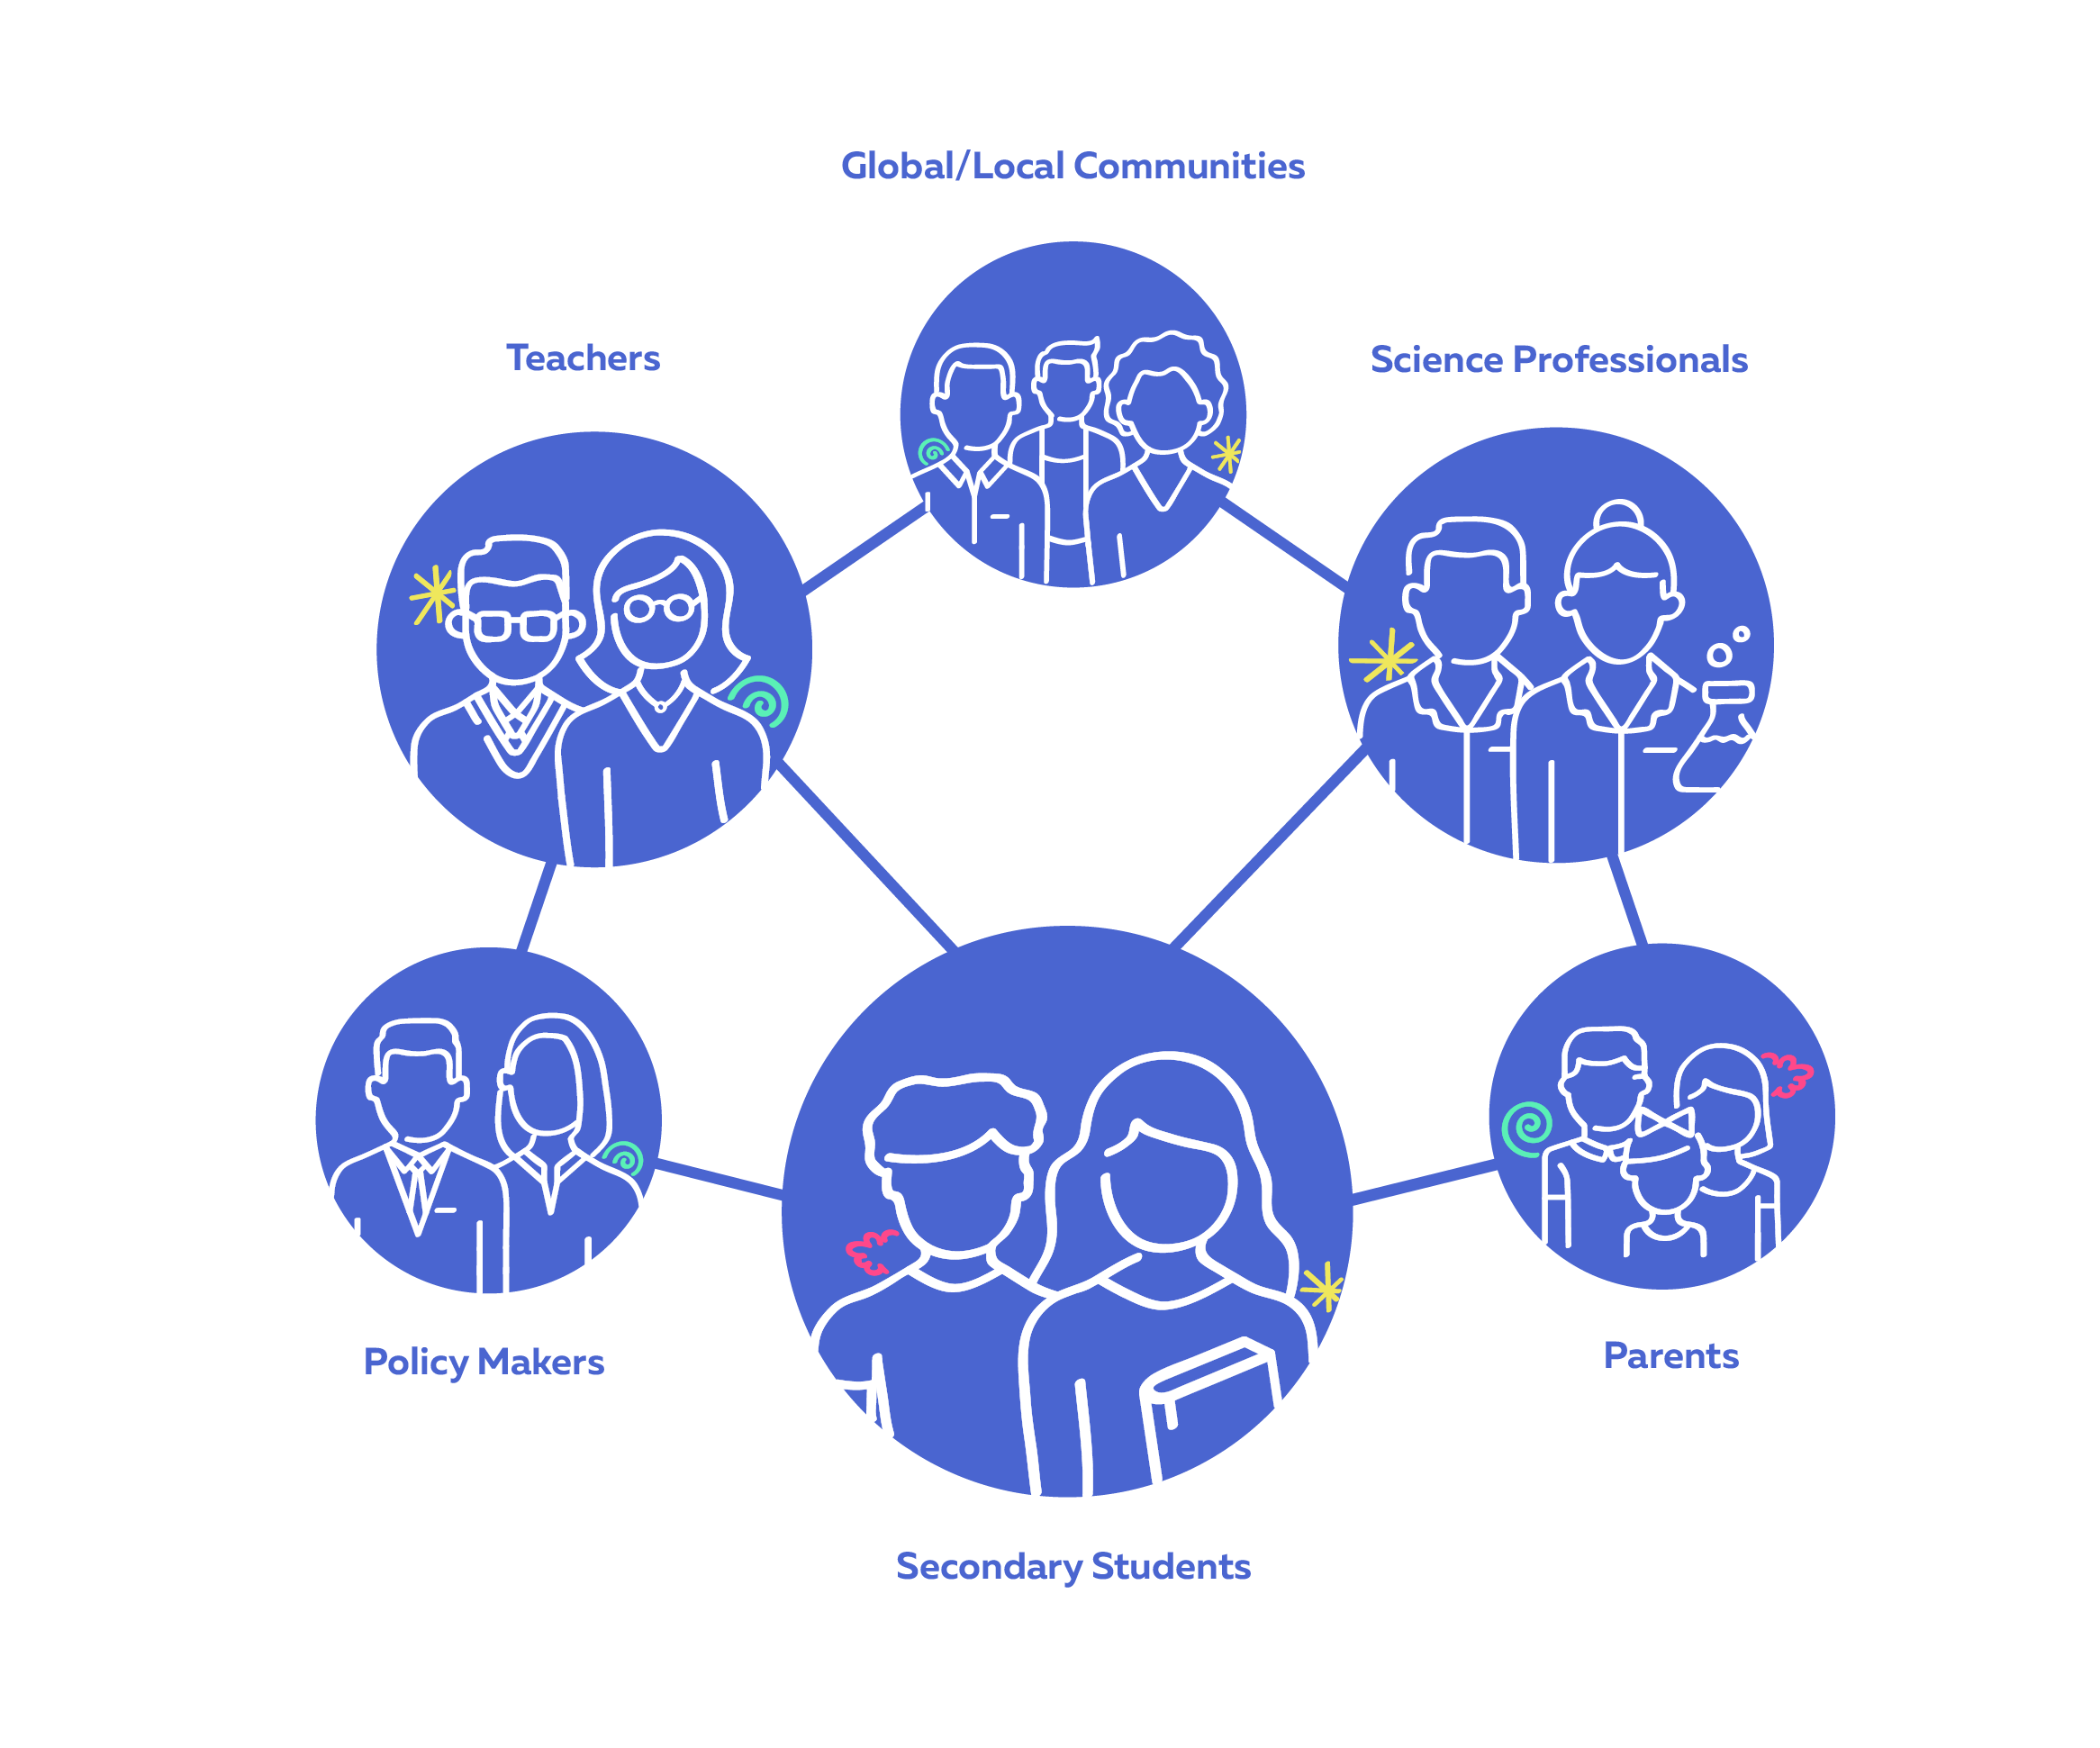
d) CONNECT Partnerships
Partnerships are formalized through a formal agreement between teachers, students, parents and / or representatives of other institutions / organizations.
Partnership policies will sustain CONNECT’s open schooling model within partners’ institutions and spread the model to new ones.

Slide 23
e) CONNECT Coaching
In CONNECT, we consider the ‘coach as a facilitator of learning’.
The coaching process in CONNECT includes these stages, from induction to implementation:
  Establishing the time to invest, schedule and objectives;
  Evaluating and anchoring in reality;
  Visualizing the results;
  Identifying solutions and options;
  Analysing the resources.
For each stage, there are specific questions addressed to the coached person.
Coaching is a process that aims to improve performance and focuses on the ‘here and now’ rather than on the distant past or future

Slide 24
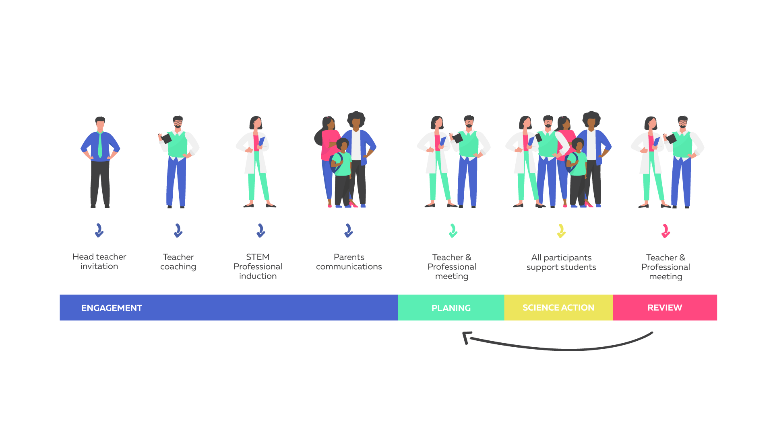
f) CONNECT engagement plan
CONNECT facilitates an engagement plan to guide teachers to interact with the different stakeholders: scientists, families, coaches...
Notes:
we-CARE informal learning with professionals and family introducing the challenge
we-KNOW formal learning focused on the students’ acquiring the scientific understanding and skills
we-DO students turn their knowledge and skills into participatory science-action including an evaluation

Slide 25
4. CONNECT in a nutshell

Slide 26
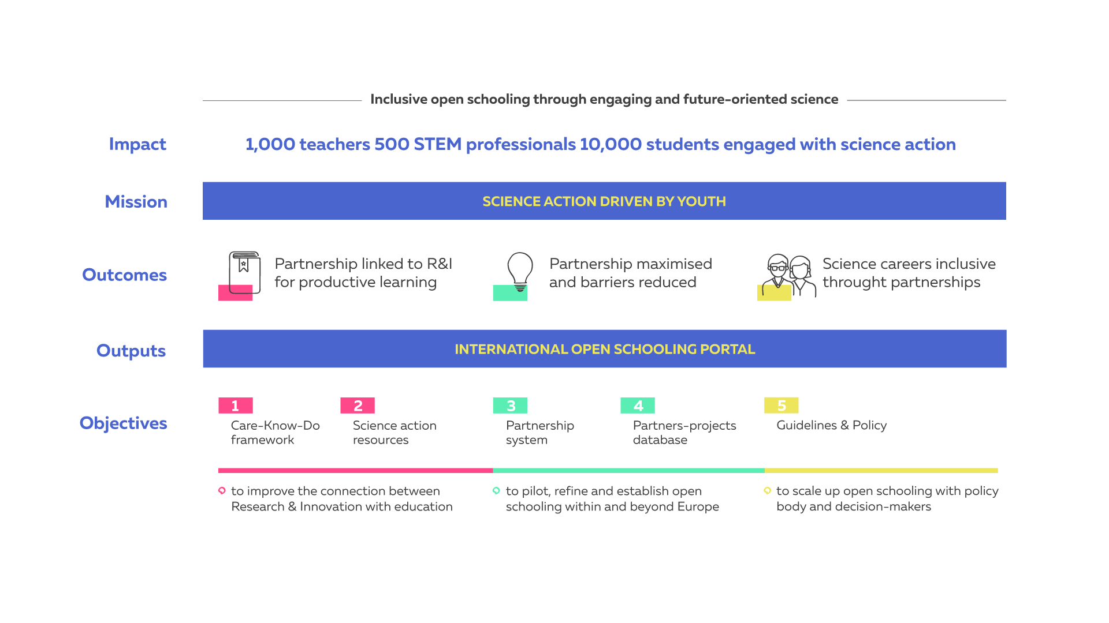
CONNECT in a nutshell

Slide 27
CONNECT Goals
 | Establish and support science-actions for:
YEAR 1 | 1200 students in 20 schools involving 20 science professionals from 5 countries To raise interest and pilot CONNECT’s model
YEAR 2 | 15,000 students in 100 schools involving 250 science professionals To establish a tested model for science-action partnerships.
YEAR 3 | 31,500 students in 210 schools involving 525 science professionals To maintain and spread the CONNECT’s open schooling model

Slide 28
5. HOW to benefit from CONNECT?

Slide 29
What could prevent me, as a teacher, to promote change towards open schooling?
I see that there is a room to improve my science teaching and I can start with a first step with CONNECT
The skills linked with the scientific method are a key part of the curricula that I could better address with CONNECT resources
Promoting Science capital by engaging stakeholders is difficult & takes time
Students acting as citizen scientists to respond to local challenges with and for the community can be very motivating and socially relevant
Tight curricula
My science lessons are already highly valued by my students
I do not know how to start the change
CONNECT can help you with Coachers and an Engagement Plan
Engagement of families, communities and scientists is key to increase science capital and to learn with real data
I do not see the value of collaborating with stakeholders outside my school
It is not my duty to improve the role of science in my community
Collaborating with the community could help to demistify the idea that science is distant and to gain recognition for my school

Slide 30
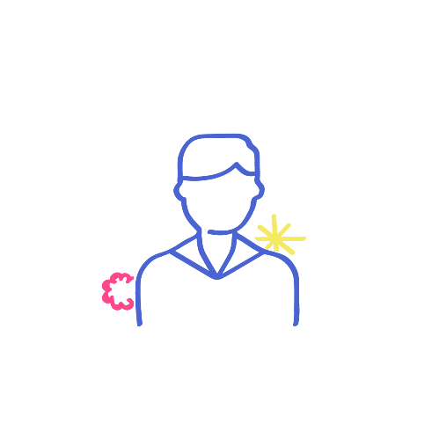
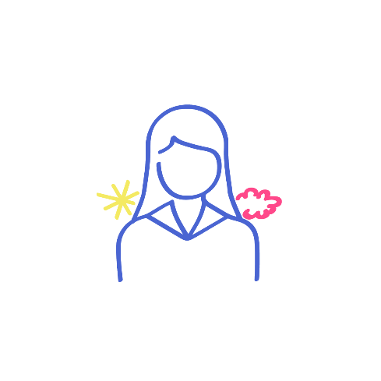

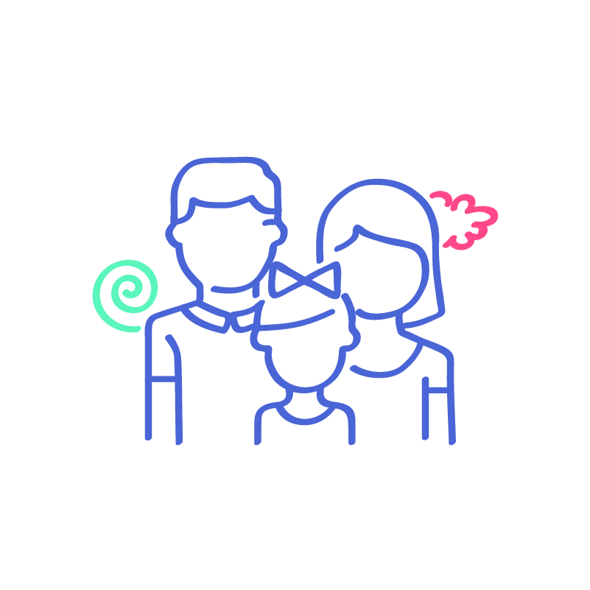
CONNECT’s benefits …
… for schools
Promotes recognition as an innovative school to better fit with societal needs.
  CONNECT will announce that the school joins the project at the website and through social media
  A blog article and a press release at local level will inform about the schools that have participated in each region (at the end of implementation phase)
  Outcomes will be disseminated through social media to contribute to raise local awareness
  Participation badges will be offered to participants after the implementation
  Best practices will be eligible for a special award to promote recognition
Makes secondary schools more inclusive and accessible by increasing the capabilities and motivation towards science careers for all students equally
Improves learning outcomes
… for students
Activates their curiosity
Promotes to apply science in real-life scenarios
Increases their confidence in problem solving through science
Facilitates meaningful learning through engaging activities
Contributes to increase science capital
… for families
Empowers them with scientific literacy
Gives family members an opportunity to be involved in the students’ science education
Stimulates a shared interest and raises awareness of science and future careers

Slide 31

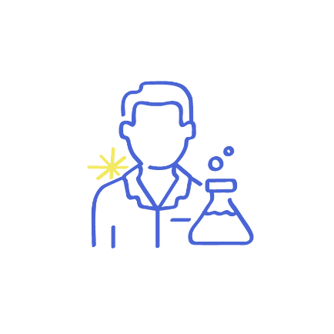
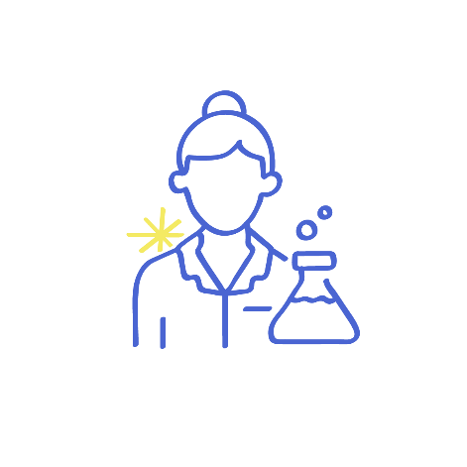
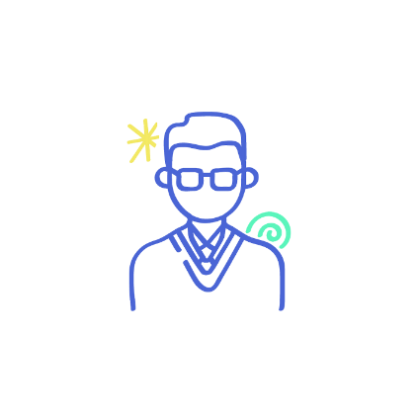
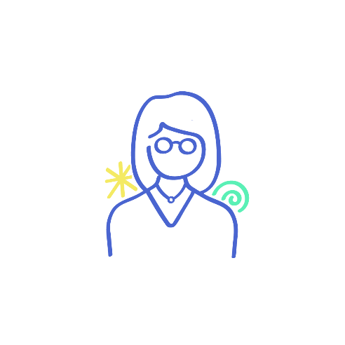
CONNECT’s benefits …
… for science professionals
Contributes to scientists’ personal and professional fulfilment by sharing their passion with young people
Allows them to act as role models for youth
… for research centres, universities and enterprises
Contributes to raise local awareness and recognition by announcing partnerships with schools in the CONNECT website, and disseminating it through a blog article, a press release and publications in social media
Motivates potential future employees
Promotes dissemination of their participatory-science
… for policy makers
Contributes to improve science education
Inspires them to design policies to address local community needs through participatory science in collaboration with education community, scientists and other stakeholders

Slide 32
6. HOW to get involved in
CONNECT?

Slide 33
HOW to get involved in CONNECT
Are you a secondary school teacher or from a secondary school administration with interest in adopting CONNECT’s model for inclusive open schooling?
Are you a STEM professional, scientist, enterprise researcher with interest in motivating young students into pursuing scientific careers through CONNECT’s activities?
Are you a parent, grandparent, tutor or family member looking for being more involved in the school activities?
Συμπλήρωσε το https://tinyurl.com/engagementwithconnect για να μάθεις πως μπορείς να συμμετέχεις

Slide 34
CONNECT supporting bodies
USER ADVISORY BOARD (Ελληνική Κοινότητα Scientix ?)
CONNECT’s User Advisory Board (UAB) is composed of prospective end-users from the educational field and other interested stakeholders that support the project ensuring the relevance and quality by providing feedback and recommendations.
EXPERT ADVISORY BOARD
CONNECT’s Expert Advisory Board (EAB) is composed by people from the scientific fields addressed during the project, who will provide valuable insight and recommendations on the activities conducted in the project.

Slide 36
Ευχαριστώ! https://www.connect-science.net/ panselin@gmail.com

